Slide 1
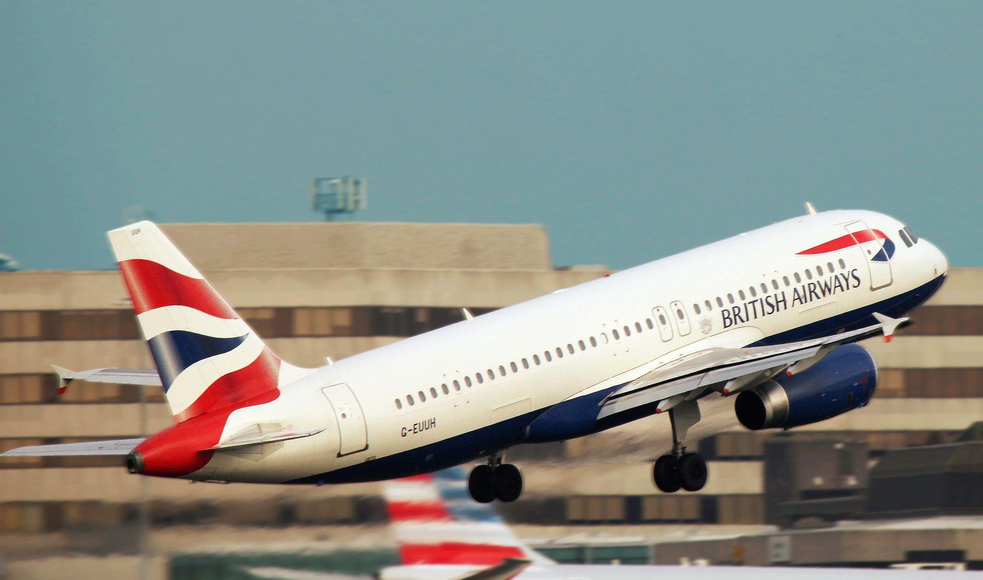

Slide 2
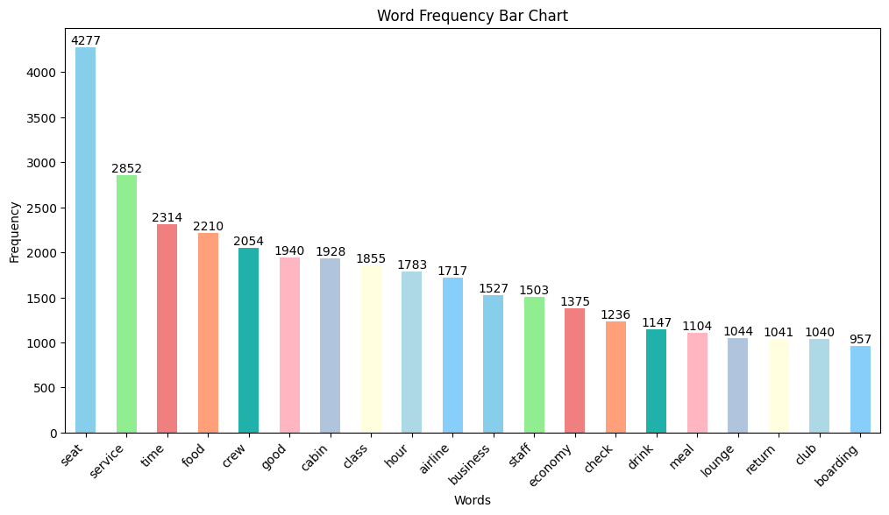
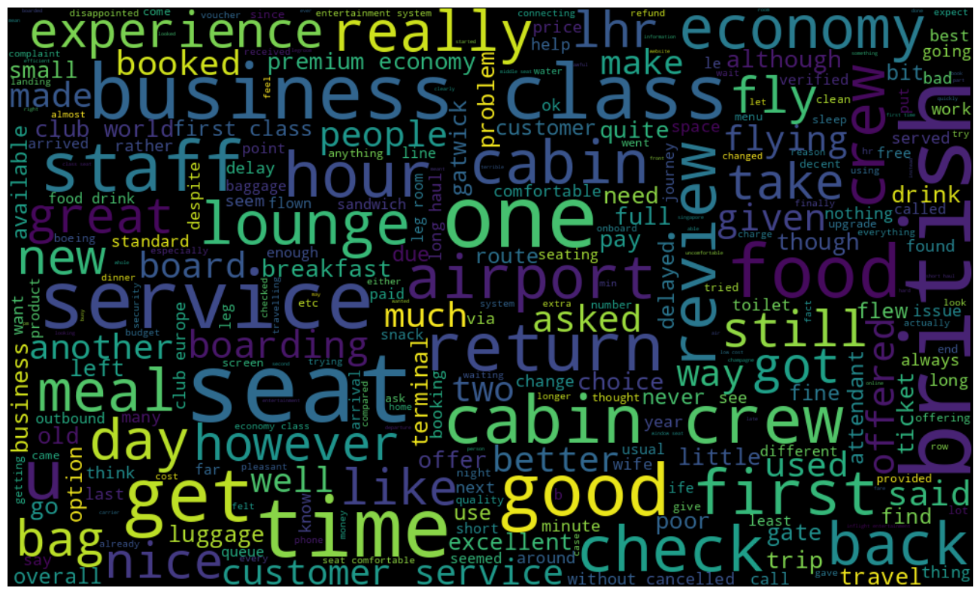
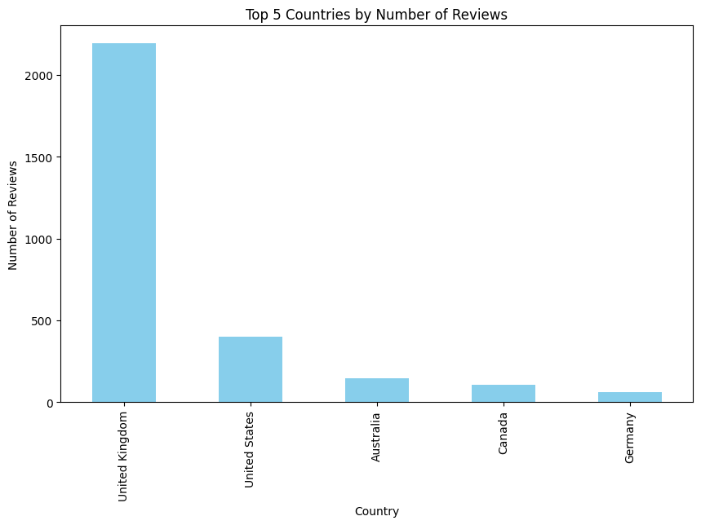
TITLE
Analyzing customer satisfaction across various rating classes.
7-10 ratings: comfortable seats, good inflight entertainment,descent food quality.
4-6 ratings: customers faced problems with small entertainment screen, long passport check queue, bad business class experience.
1-3 ratings: customers were dissatisfied on congested middle seat and screen. They liked the seats and the food.
All customers liked the cabin crew service and stuff. The seats were generally economy seats and many customers travelled in business class.
Key points:
Economy class service, seats,enhance inflight environment experience and very importantly delays.
Improve the experience of the business class.
Improve customer service on refund requests and processes.

